Slide 1
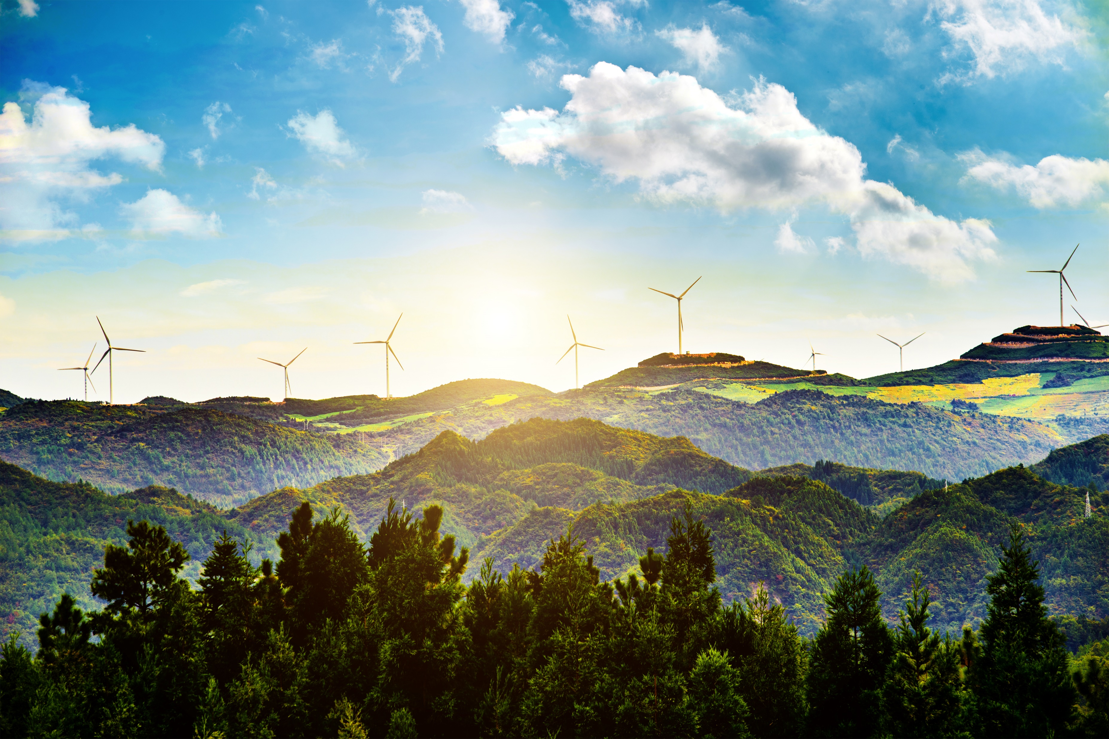

Clim
-Control
The Social Awareness to protect the world.

Slide 2



TEAM MEMBERS
Rachit Shrivastava
0187CS211127
4th Sem
Student at Sagar Institute of science and technology
Anushka Kishor
0187CS2110-33
4th Sem
Student at Sagar Institute of science and technology
Rehan Khan
0187CS211133
4th Sem
Student at Sagar Institute of science and technology
Yash Soni
0187CS211188
4th Sem
Student at Sagar Institute of science and technology

Slide 3
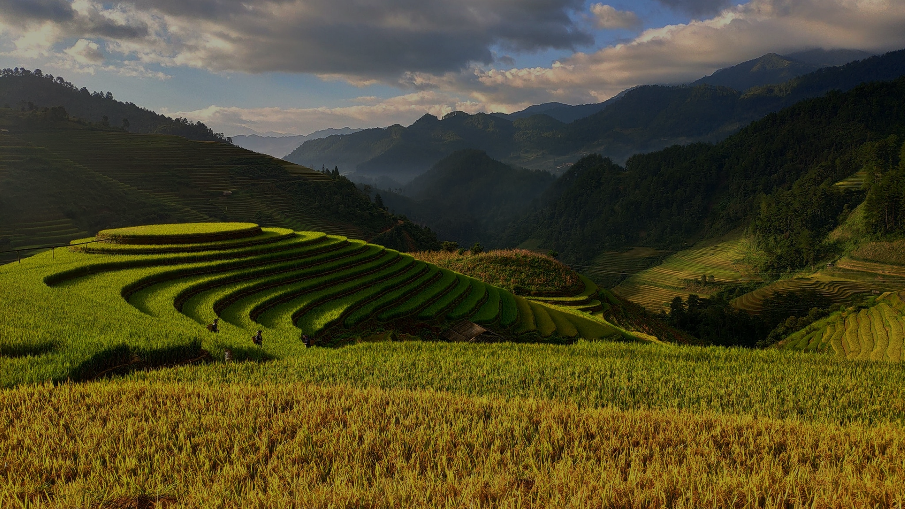
Climate Measures
The purpose of this presentation is to educate and raise awareness about the importance of climate control in our world today. Climate change is one of the biggest challenges we face, and its consequences are already being felt in different parts of the world.

Slide 4
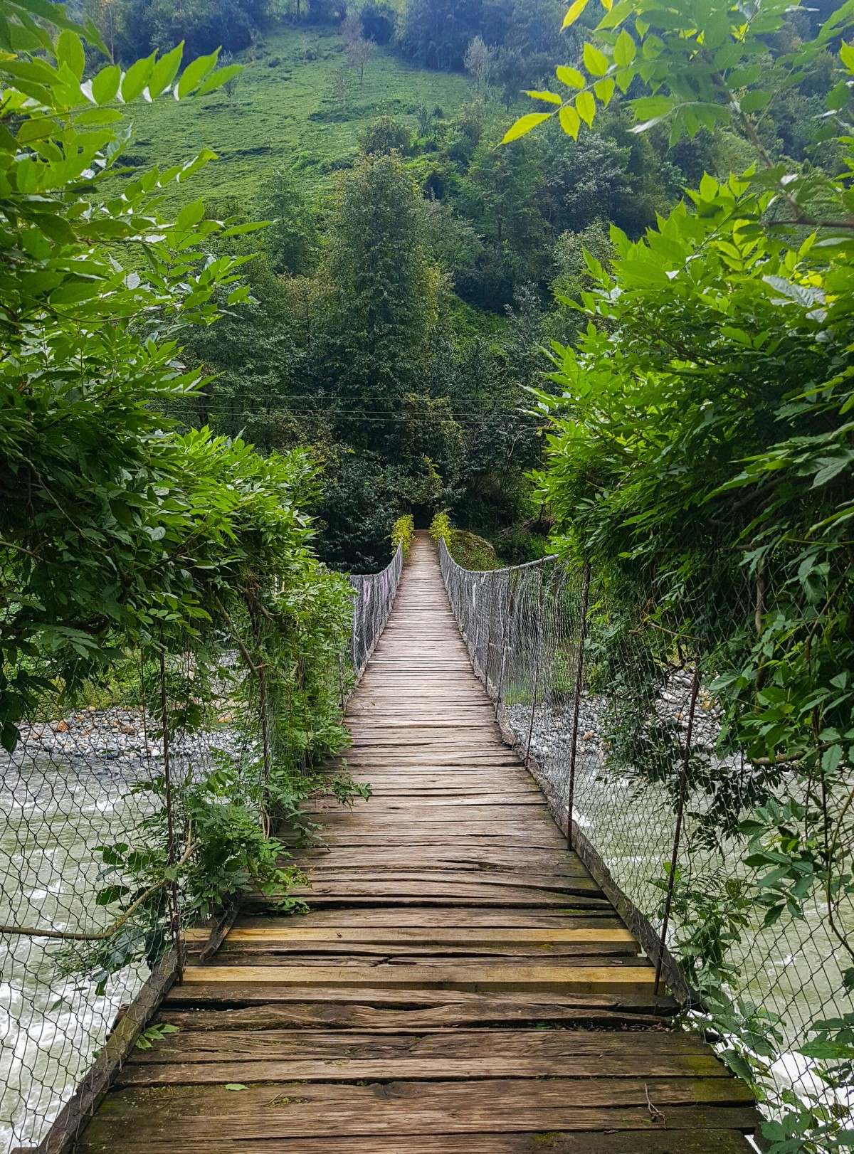

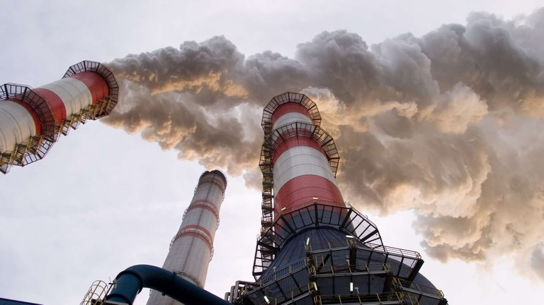


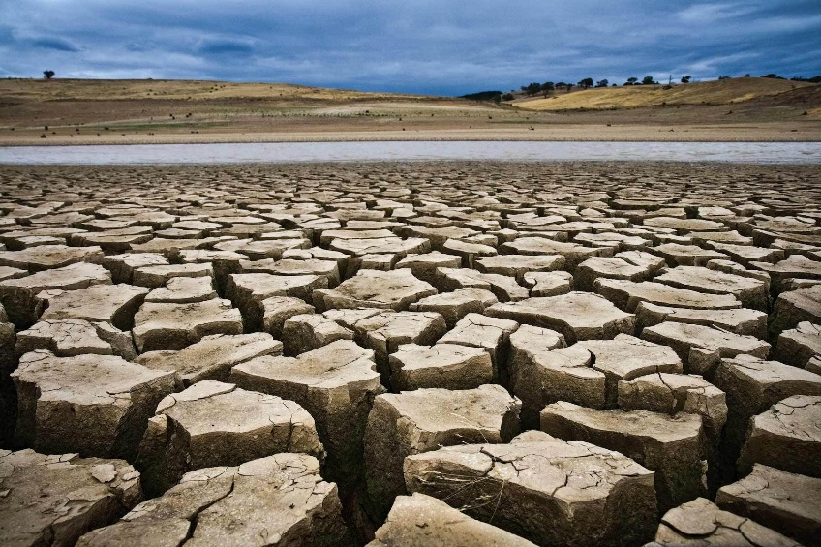


Problem Identification
In 2021, the global mean temperature was about 1.1°C above the pre-industrial level (from 1850 to 1900). The years from 2015 to 2021 were the seven warmest on record.
About one third of global land areas will suffer at least moderate drought by 2100.
The global annual mean temperature is projected to rise beyond 1.5°C above pre-industrial levels in at least one of the next five years
By 2030, an estimated 700 million people will be at risk of displacement by drought alone.

Slide 5




Global State of Climate
The Earth's climate is constantly changing and is influenced by various factors such as greenhouse gas emissions, natural climate variability, and human activities.
Efforts to mitigate the effects of climate change are underway at both the national and international levels, including the Paris Agreement, which aims to limit global warming to well below 2 degrees Celsius above pre-industrial levels.
These changes have significant impacts on human societies and ecosystems, including impacts on agriculture, water resources, and biodiversity.
The consequences of this warming trend include rising sea levels, more frequent and intense heatwaves, changes in precipitation patterns, and more frequent and severe natural disasters such as hurricanes, floods, and wildfires.

Slide 6

State of Climate in India
India is a country in which around 60% of the population is in rural areas.
The state of climate in India is complex and diverse, with varying weather patterns across different regions.
The climate of India can affect economic growth, particularly in sectors such as agriculture, tourism, and energy.
India has a high potential to feed the world with all essential Climatic Features and manpower to protect it, The only requirement is correct knowledge and
tech innovation is required to excel.
60%

Slide 7
Clim-Control features
Primary feature
Build awareness and understanding
Develop early warning systems
Implement risk reduction measures
Integrate climate change into national planning processes
Establish institutional arrangements
Secondary features
Promote gender and social
Inclusion
Provide technical assistance and
support
Strengthen partnerships and collaboration
Share videos that explain the science of climate change and the impacts it is having on our planet.
Partner with NGO’s and schools

Slide 8




UNIQUENESS
The distinctive feature of this project is to give solutions for climate measures, with a voice module and an animation so that every person can understand the problem.
People from Rural can get information directly from World safety NGOs, a safe and transparent platform for contact between people and NGOs.
People can make their network because better communication always results in Development. So, it will help us to gather more unpredictable information that can potentially lead us to harmful effects on the environment.
Problem-specific animated Video courses for sustainable control measures will show the results of the test that are very harmful to the environment. It’ll give a better view of the perspective of betterment.

Slide 9
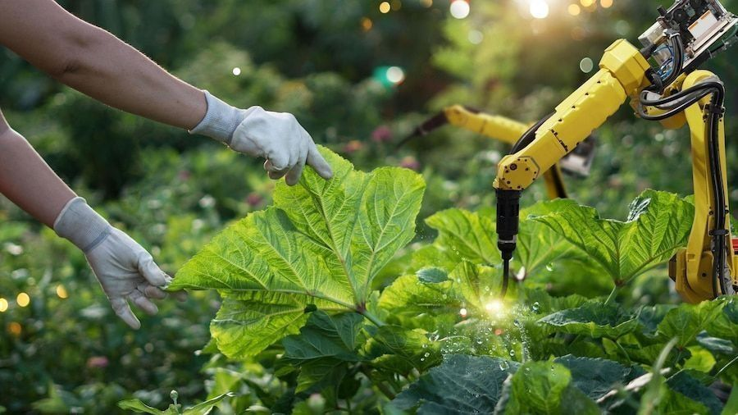
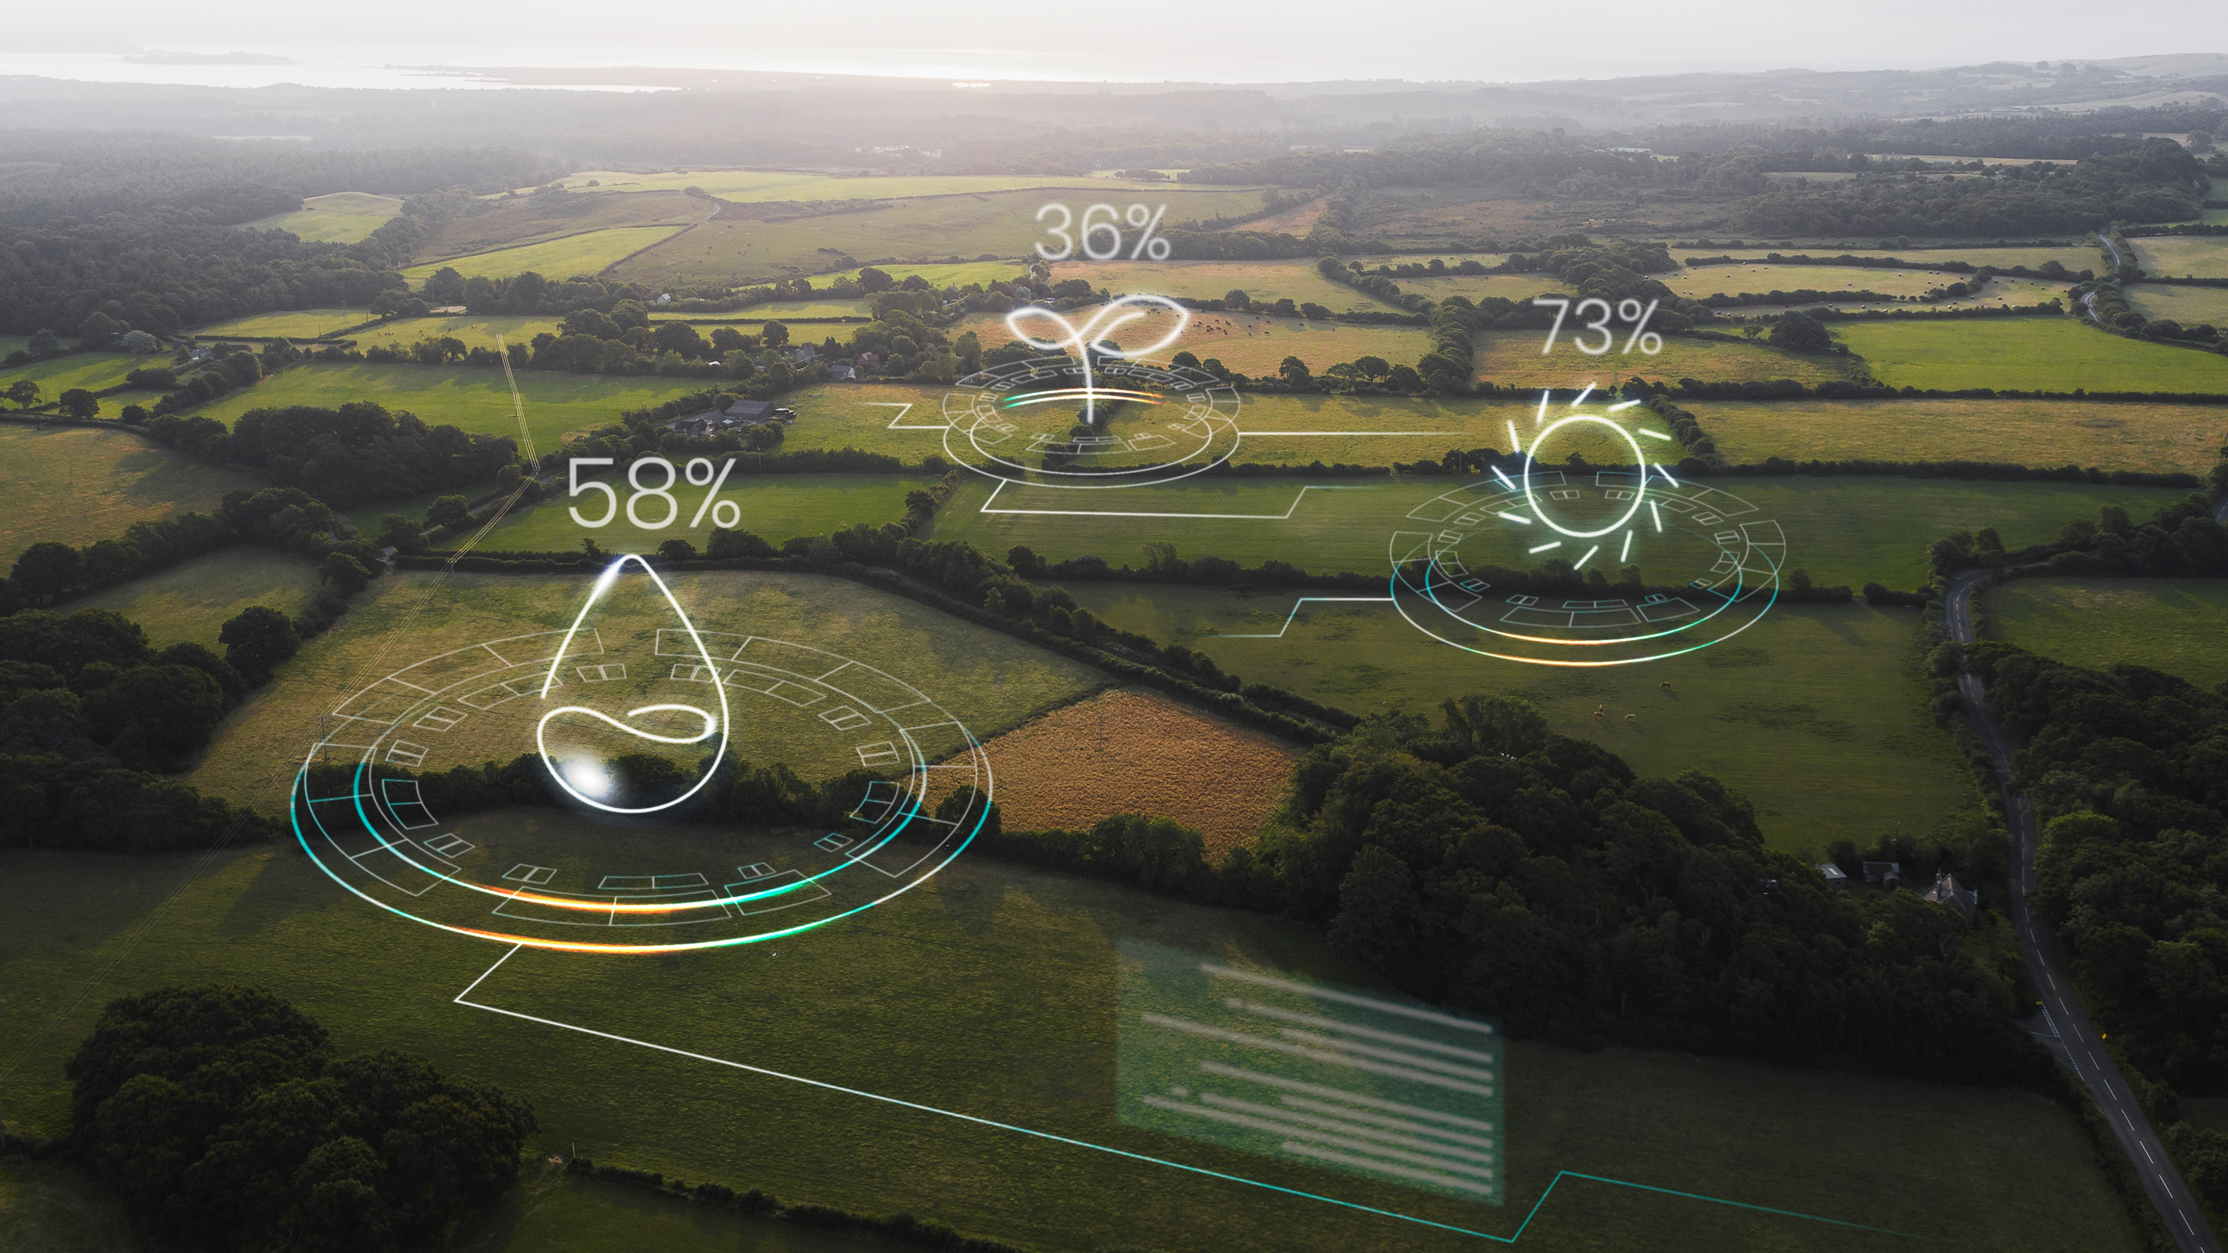

Concept & Objective

Slide 10
Concept
Objectives
The objective is to provide a convenient facility to farmers and to the people which enables them to self-diagnose their surroundings and get an effective solution for the problem and connect with the world to make climate efficient and sustainable
Limiting global warming
Increasing energy efficiency
Building resilience
Make People aware of the conditions
More experimental knowledge that we can obtain in real life.
Put this knowledge into animations for better understanding.

Slide 11



Technical Viability
All the animator will work their best to make people understand about the unpredictable effects.
Increase reach to renowned Ngo’s so that the awareness gets up to all the people.
the quality of Data set improve the prediction probability percentage will also gets improve and become more reliable.

Slide 12



Financial Viability
The start-ups and Govt are investing in developing software that would cater to the digital agriculture market.
The Department of Climate and Disaster welfare introduced various schemes to finance and support Environment.
The transition to a low-carbon economy can also create new employment opportunities in sectors such as renewable energy, energy efficiency, and sustainable transport.
The European Commission 2020 launched Horizon Europe Program, under which research and innovation are key driving factors.

Slide 13


Project Cost
We need funding in three basic areas
Research
For research, we need cameras and a team for collecting information and the dataset as well as essential survey information
Clim
Development
For creating the best animations we need high-performance computational devices and developers for animated video building
Control
Content
We need the best experts for the correct content on the application and for making video courses.

Slide 14

Thank
You
To give us your precious Time and Understand our concept and Idea

